Slide 1

Healthcare - Predictive Analytics (Cardio Data)
Presentation: Daideepya Awadhiya

Slide 2
Agenda
Introduction: Overview of Cardio Data
EDD analysis
Visualizations
Outliers remove
Training and Testing the data
Model selection
Recommendation

Slide 3
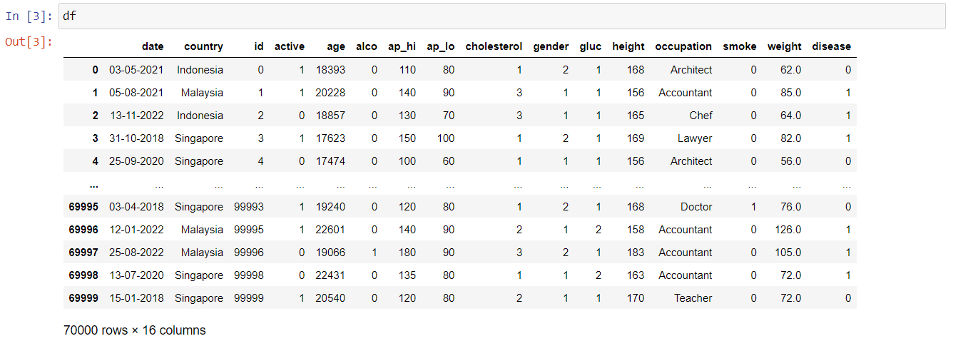
Overview of data

Slide 4
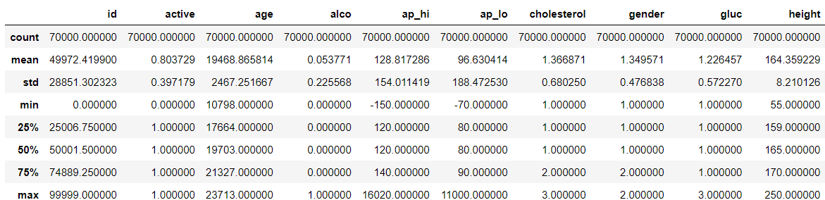
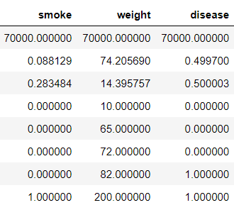
EDD Analysis
Average age of people is 53.30
Average people of disease is 0.49
Various outliers found in 'ap_hi' and 'ap_lo' columns
Negative value shows in "min" is not possible of blood pressure
Converting age into years

Slide 5
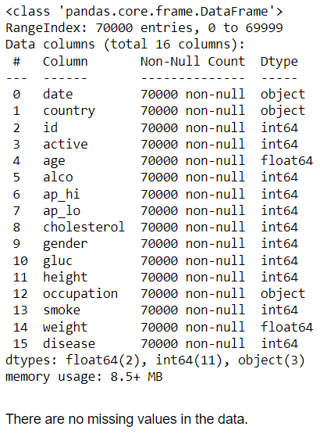
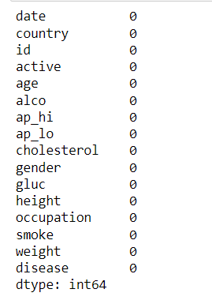
Checking Null Values in the Data

Slide 6
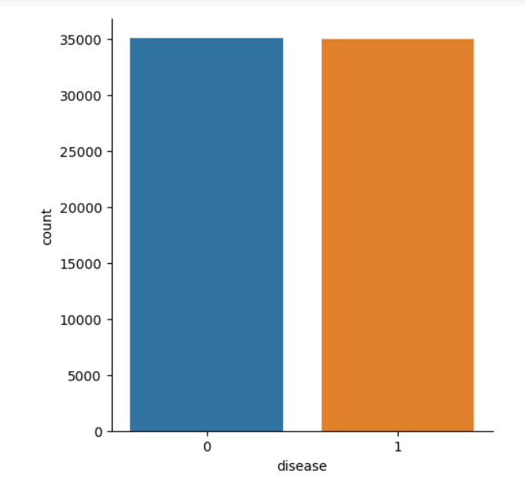
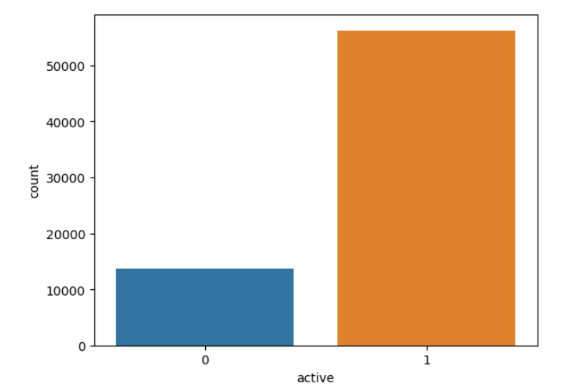
Almost half of Patient have Cardio disease
The physical activity of the patient
No physical Activity: 0
Physical Activity: 1

Slide 7
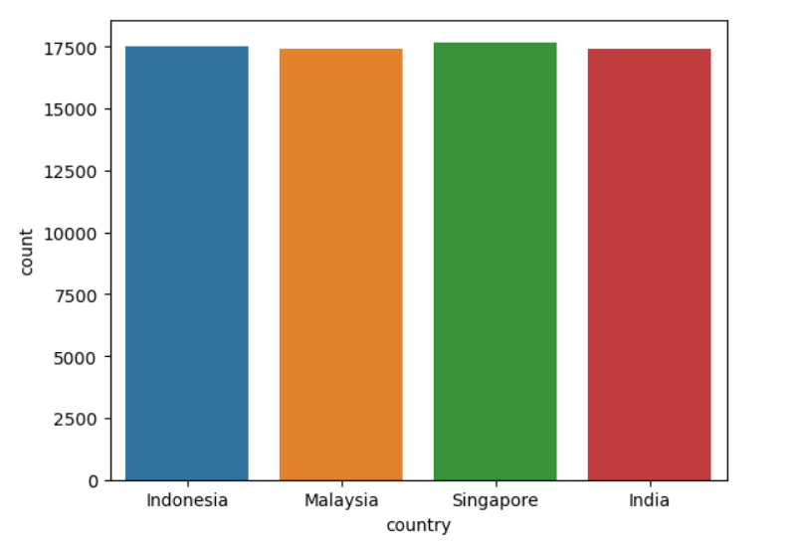
We have 4 Countries of data ( Indonesia, Malaysia, Singapore, India) which shows almost same amount of patients

Slide 8
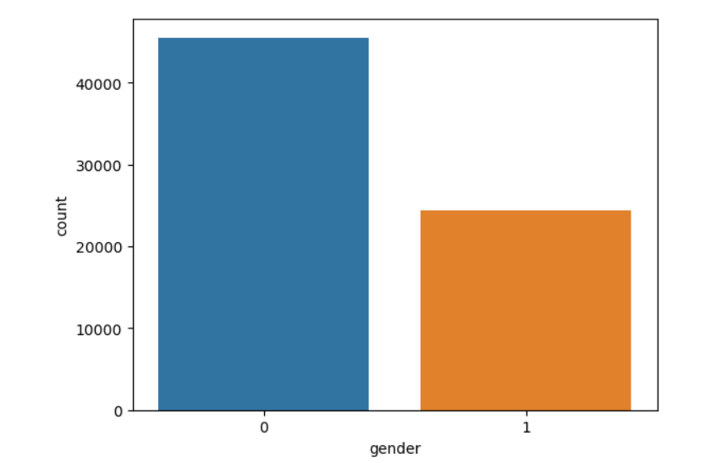
Female participation is more
(Female: 0, Male: 1)

Slide 9
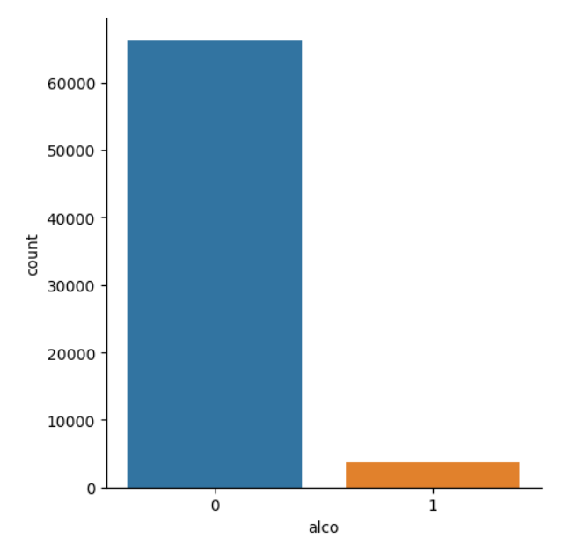
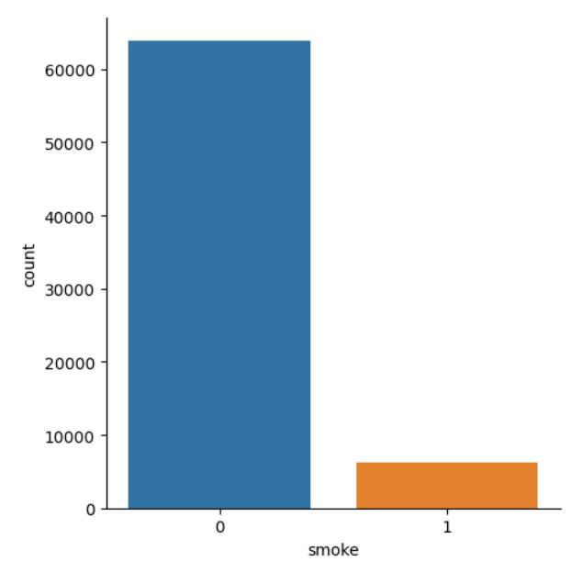
Alcoholic intake (0 for Negative and 1 for Positive)
Smoke intake (0 for Negative and 1 for Positive)

Slide 10
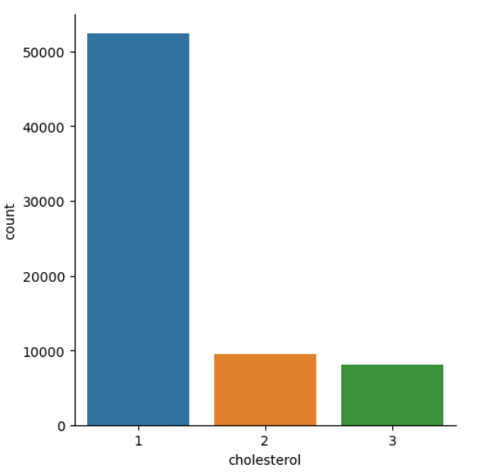
Cholesterol level of the patient. (Normal:1 , Above normal : 2, High: 3)

Slide 11
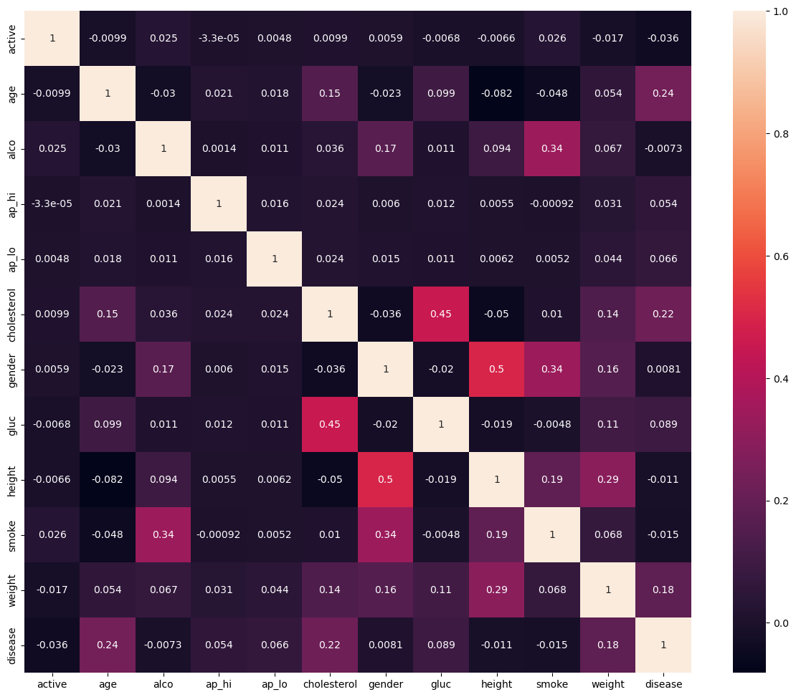
Main Cause of disease are:
1.High blood pressure
2.Smoking
3.Overwieght
4.High cholesterol

Slide 12
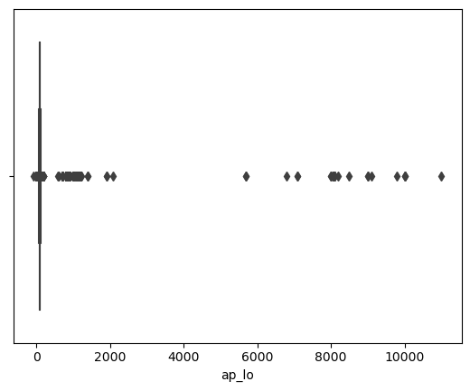
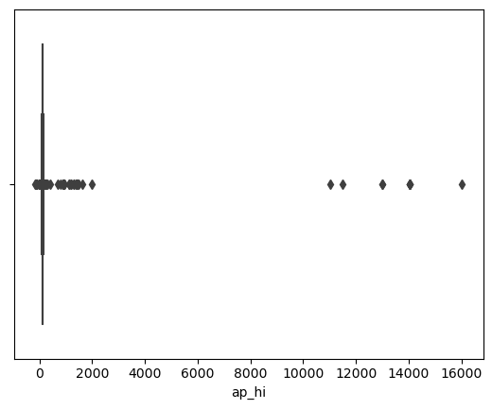
Pre-Processing Data
Outliers effect the performance of our model which is present in columns "ap_lo" and "ap_hi"

Slide 13
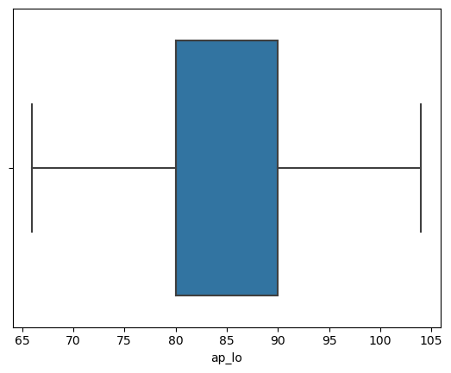
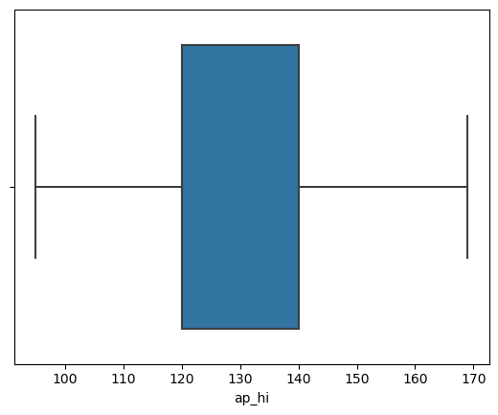
After Treatment of Outliers

Slide 14
Training and Testing the Data
x_multi = df.drop(['disease'], axis=1)
y_multi = df['disease']
from sklearn.model_selection import train_test_split
# Split the data into training and testing sets
x_train, x_test, y_train, y_test = train_test_split(x_multi, y_multi, test_size=0.2, random_state=42)

Slide 15
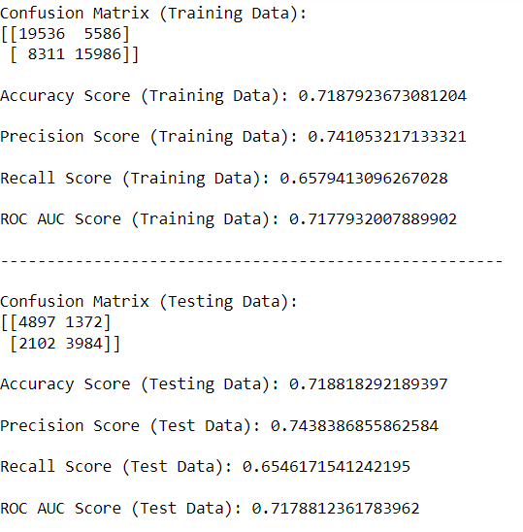
Decision Tree
Decision Tree - Accuracy Score (Train): 71.8792% Decision Tree - Accuracy Score (Test): 71.8818% Decision Tree - ROC AUC Score (Test): 0.7179
Decision Tree - Recall Score (Test): 0.6546
Decision Tree - Precision Score (Test): 0.7438

Slide 16
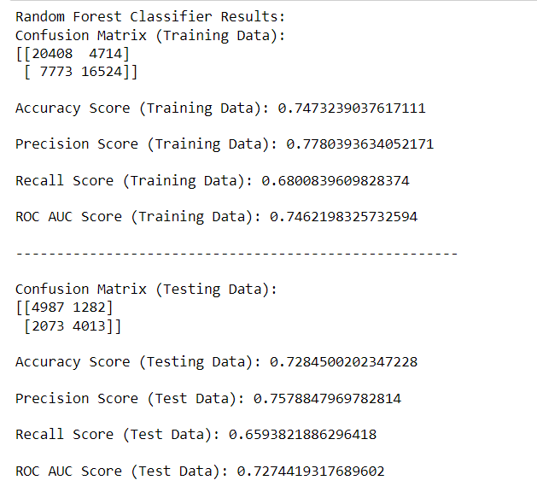
Random Forest
Random Forest - Accuracy Score (Train): 74.7324% Random Forest - Accuracy Score (Test): 72.8450% Random Forest - ROC AUC Score (Test): 0.7274 Random Forest - Recall Score (Test): 0.6594 Random Forest - Precision Score (Test): 0.7579

Slide 17
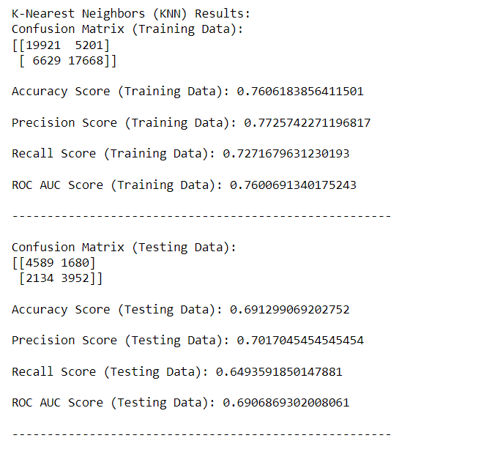
KNN
K-Nearest Neighbors - Accuracy Score (Train): 76.0618%
K-Nearest Neighbors - Accuracy Score (Test): 69.1299%
K-Nearest Neighbors - ROC AUC Score (Test): 0.6907
K-Nearest Neighbors - Recall Score (Test): 0.6494
K-Nearest Neighbors - Precision Score (Test): 0.7017

Slide 18
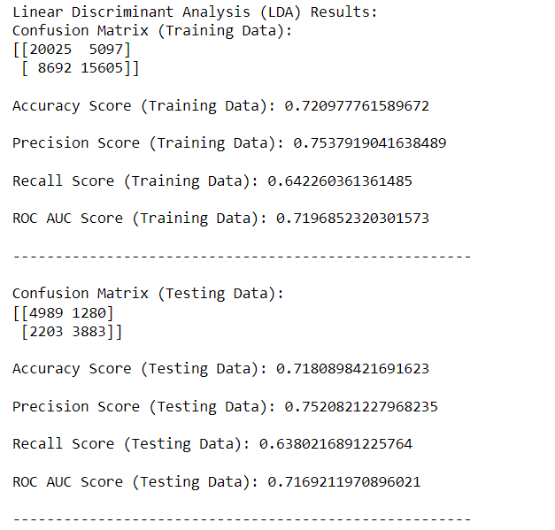
LDA (Linear discriminant analysis)
Linear Discriminant Analysis - Accuracy Score (Train): 72.0978%
Linear Discriminant Analysis - Accuracy Score (Test): 71.8090%
Linear Discriminant Analysis - ROC AUC Score (Test): 0.7169
Linear Discriminant Analysis - Recall Score (Test): 0.6380
Linear Discriminant Analysis - Precision Score (Test): 0.7521

Slide 19
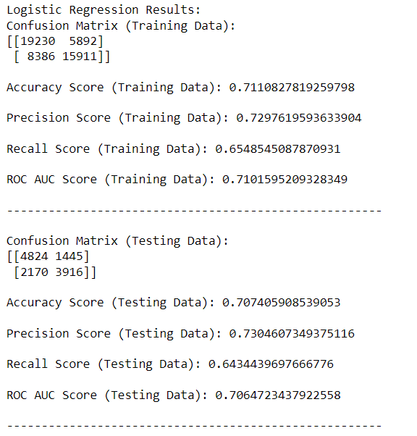
Logistic Regression
Logistic Regression - Accuracy Score (Train): 71.1083% Logistic Regression - Accuracy Score (Test): 70.7406% Logistic Regression - ROC AUC Score (Test): 0.7065
Logistic Regression - Recall Score (Test): 0.6434
Logistic Regression - Precision Score (Test): 0.7305

Slide 20
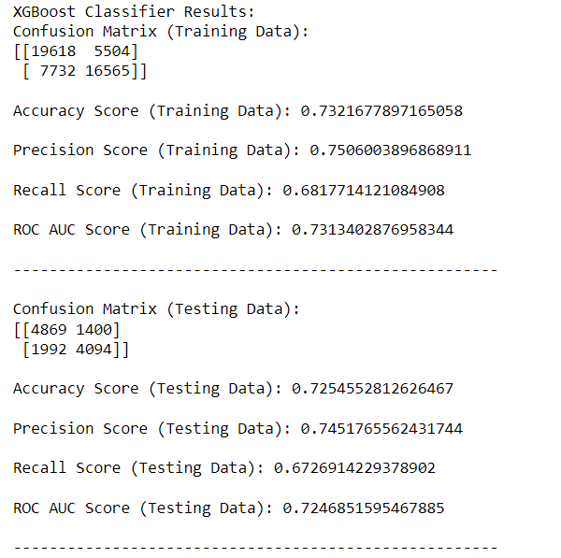
XGBOOST
XGBoost - Accuracy Score (Train): 73.2168%
XGBoost - Accuracy Score (Test): 72.5455%
XGBoost - ROC AUC Score (Test): 0.7247
XGBoost - Recall Score (Test): 0.6727
XGBoost - Precision Score (Test): 0.7452

Slide 21
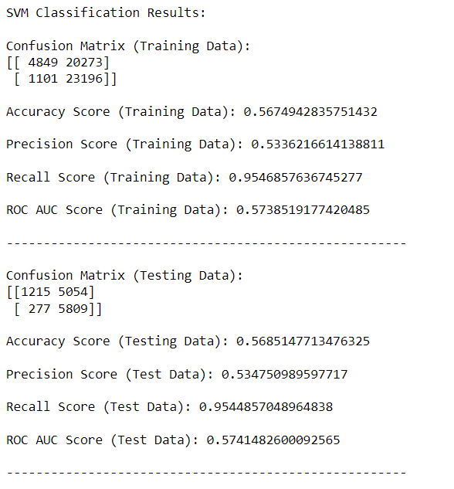
SVM
SVM - Accuracy Score (Train): 56.7494% SVM - Accuracy Score (Test): 56.8515% SVM - ROC AUC Score (Test): 0.5741
SVM - Recall Score (Test): 0.9545
SVM - Precision Score (Test): 0.5348

Slide 22
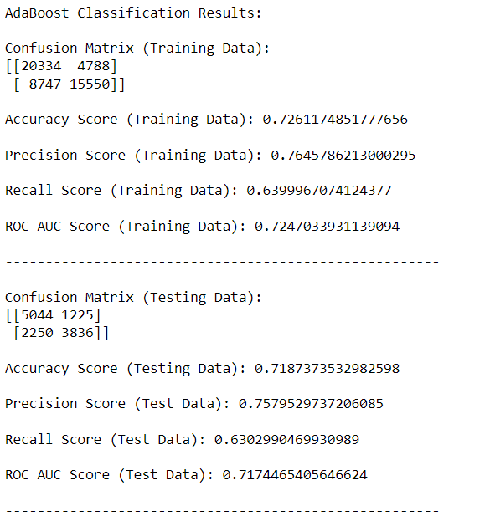
ADA (Adaptive Boosting)
AdaBoost - Accuracy Score (Train): 72.6117% AdaBoost - Accuracy Score (Test): 71.8737% AdaBoost - ROC AUC Score (Test): 0.7174 AdaBoost - Recall Score (Test): 0.6303
AdaBoost - Precision Score (Test): 0.7580

Slide 23
Tried 8 Models
Logistic Regression
k-Nearest Neighbors
Linear Discriminant Analysis
Decision Tree
Random Forest
Ada Boost
XGBoost
SVM

Slide 24
Model Performance Overview:
The Decision Tree, Random Forest, and models have the highest test accuracy scores (around 76% ).
Random Forest and XGBoost models also have the highest ROC AUC scores (around 0.72-0.73%), indicating their ability to distinguish between positive and negative classes.
XGBoost shows good recall and precision scores, which means it balances well between true positives and false positives.
Since Random Forest and XGBoost are performing well, you might consider combining them into an ensemble model, which could potentially further improve your model's overall performance.
The SVM model is performing poorly across all metrics (accuracy, ROC AUC, recall, and precision). Consider revisiting this model; you may need to adjust hyperparameters, change the kernel function, or standardize/normalize the data to improve its performance.

Slide 25
Recommendation
1. Hyperparameter Tuning:
Randomized Search or Grid Search: Utilize hyperparameter tuning techniques like randomized search or grid search to find the optimal hyperparameters for your models.
Cross-Validation: Implement k-fold cross-validation to ensure the robustness of your model performance and avoid overfitting.
2. Focus on Random Forest and XGBoost: These models have shown strong performance across various metrics such as accuracy, ROC AUC, recall, and precision. Focus on further tuning their hyperparameters to maximize their performance. These models often perform well in a wide range of classification tasks.
3. Standardize/Normalize Features: Ensure that your features are standardized or normalized, especially for algorithms sensitive to scale, such as SVM.

Slide 26
Thank You

